Slide 1
mathfunctions

Slide 2
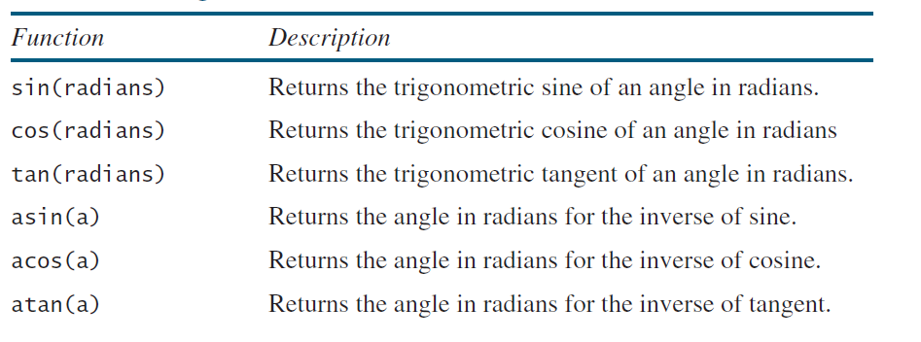
Trigonometric Functions

Slide 3
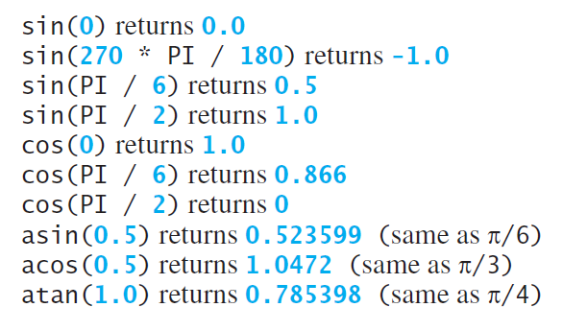

Slide 4
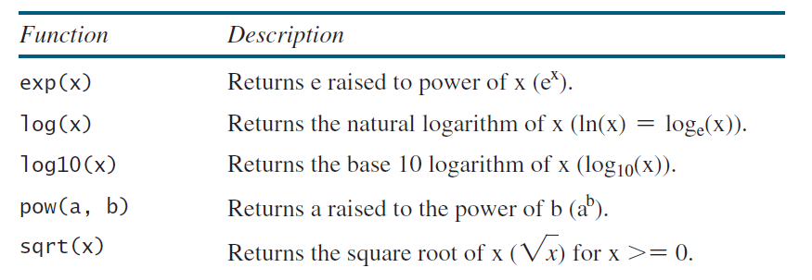
Exponent Function

Slide 5
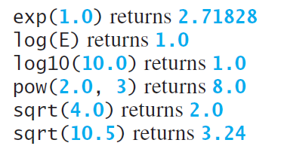

Slide 6
Rounding Functions
ceil(x) x is rounded up to its nearest integer. This integer is returned as a double value.
floor(x) x is rounded down to its nearest integer. This integer is returned as a double value

Slide 7
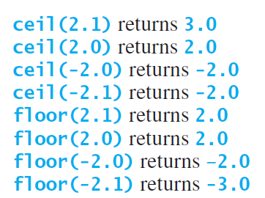

Slide 8
The min, max, and abs Functions
The min and max functions return the minimum and maximum numbers of two numbers (int,long, float, or double).
For example, max(4.4, 5.0) returns 5.0, and min(3, 2) returns 2.
The abs function returns the absolute value of the number (int, long, float, or double).
Headerfile required: cstdlib

Slide 9
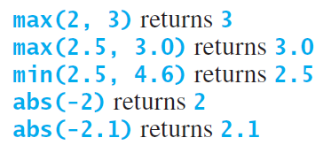

Slide 10
Character Functions
isalnum(int c): Checks if the character is alphanumeric (i.e., a letter or a digit).
isalpha(int c): Checks if the character is an alphabetic letter.
iscntrl(int c): Checks if the character is a control character.
isdigit(int c): Checks if the character is a digit.

Slide 11
isgraph(int c): Checks if the character has a graphical representation.
islower(int c): Checks if the character is a lowercase letter.
isprint(int c): Checks if the character is a printable character.
ispunct(int c): Checks if the character is a punctuation character.
isspace(int c): Checks if the character is a whitespace character.
isupper(int c): Checks if the character is an uppercase letter.
isxdigit(int c): Checks if the character is a hexadecimal digit.

Slide 12
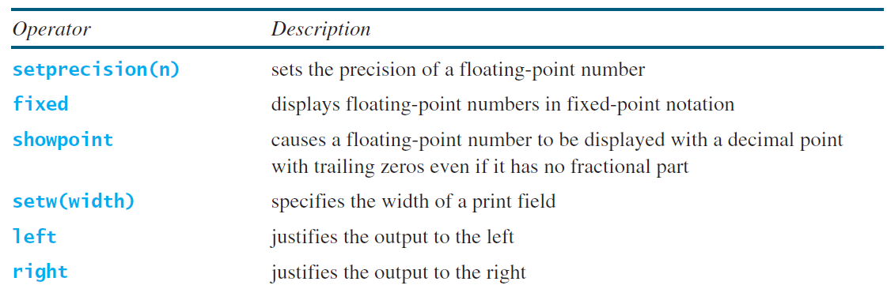
manipulators

